Slide 1

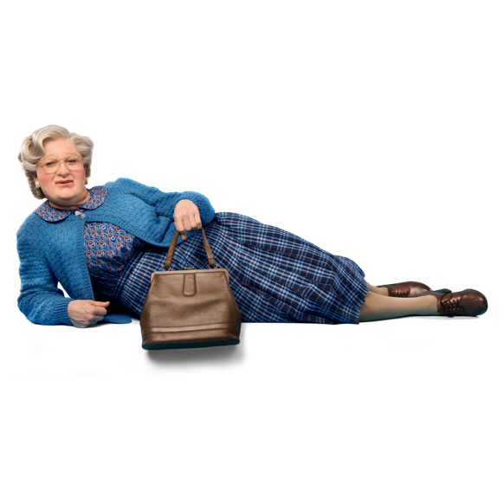
PRE – SHOW RESOURCE
PRE – SHOW RESOURCE
AN INTRODUCTION TO

Slide 2
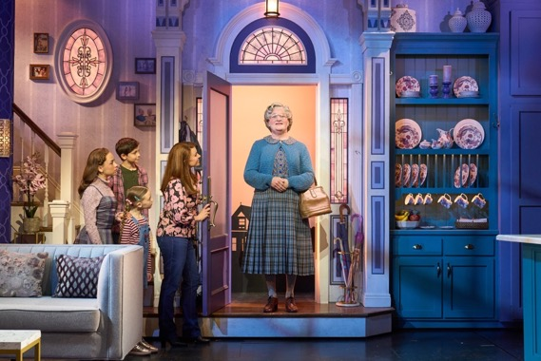
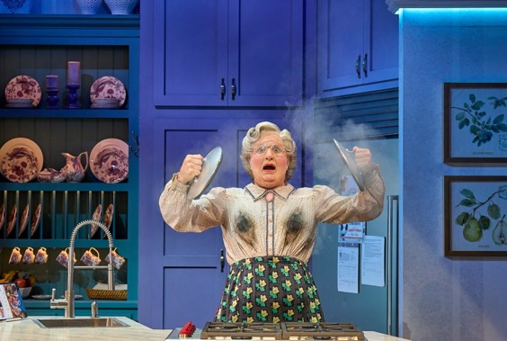
OBJECTIVES
To introduce and connect learners with the context
of Mrs. Doubtfire, The Musical
To identify what learners should look out for in the live production

Slide 3
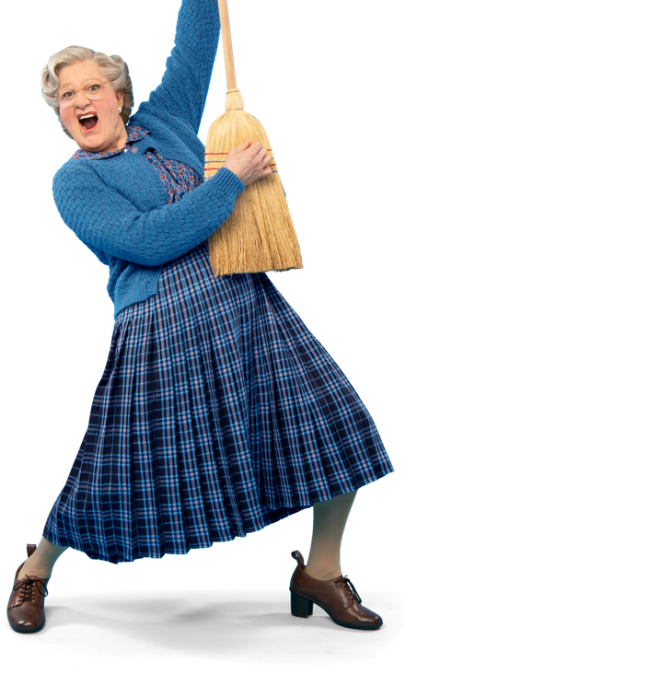
MRS DOUBTFIRE THE MUSICAL
Out-of-work actor Daniel will do anything for his kids. After losing custody in a messy divorce, he creates the alter ego of Scottish nanny Euphegenia Doubtfire in a desperate attempt to stay in their lives.
As his new character takes on a life of its own, Mrs. Doubtfire teaches Daniel more than he bargained for about how to be a father.
Direct from a sensational run up in Manchester — where
it played to sold-out crowds and standing ovations — the new comedy musical Mrs. Doubtfire is ready to dazzle and delight London's West End!

Slide 4
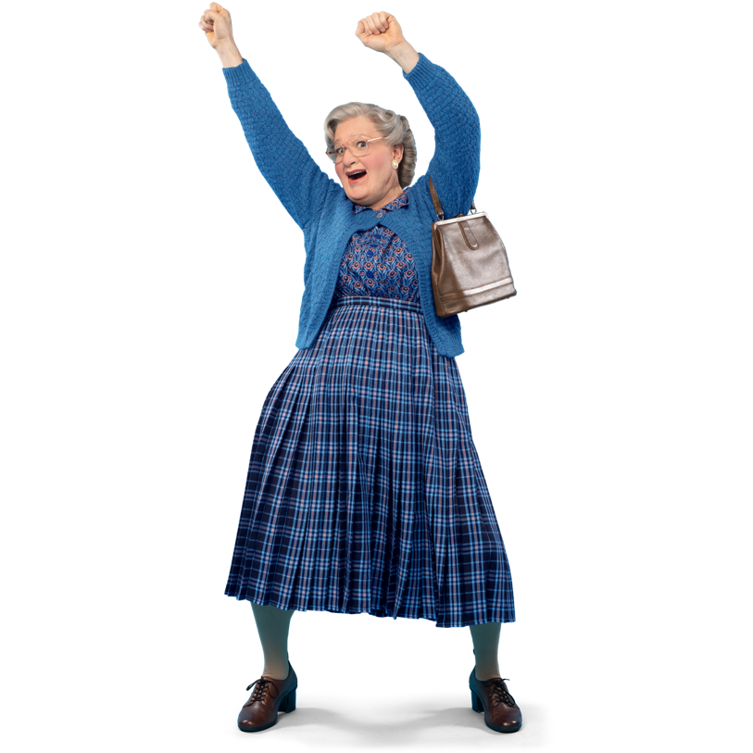
EXPECTATIONS: THINK / PAIR /
SHARE DISCUSSION
1) Based on the synopsis and review, what do you expect
to see at the theatre?
2) Have you seen the film, Mrs. Doubtfire? If yes, what do
you remember about it?
3) How do you think the musical will be different to the film?

Slide 5
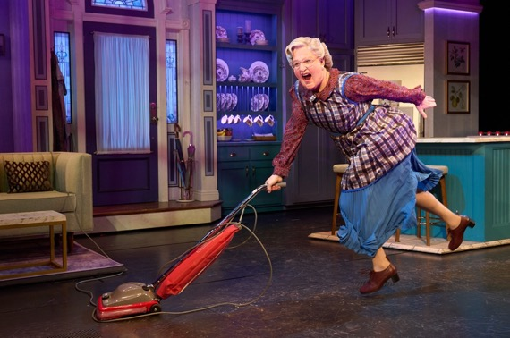
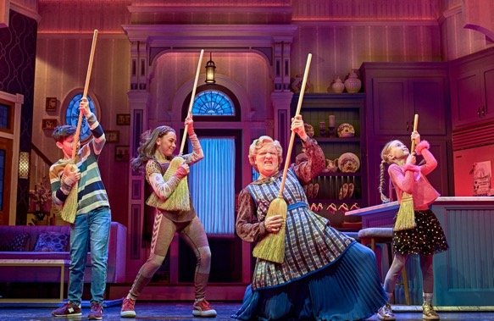
THE FILM FACTS
• Split the group in half or more, depending on size
• You will be taking part in a Fact or Fiction Quiz about
the film and need to read; Handout 1: Mrs Doubtfire Film Context Fact File

Slide 6
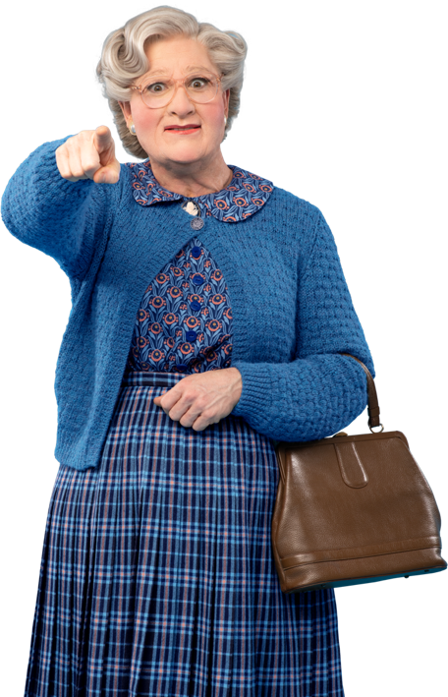
FACT OR FICTION? QUIZ
1) Anne Fine, the writer of the novel, Madame Doubtfire, named it after the owner of a shop she used to pass, which sold jewellery and old furs.
Fact: She never had time to go inside the shop and meet the owner, but remembered the name.
2) Mrs. Doubtfire is the film which made the most amount of money at the box office in 1993.
Fiction: It was the second-highest, after the mega blockbuster, Jurassic Park, which made a record breaking $914 million.
3) Over thirty minutes of scenes were deleted from the final cut of the film, including a sub plot about a feud between Mrs. Doubtfire and a neighbour character.
Fact: In these scenes, Mrs. Doubtfire persuades Gloria, the neighbour, to use cat pee on her plants!

Slide 7
FACT OR FICTION? QUIZ
4) It took up to four and a half hours to apply the Mrs. Doubtfire make up on each day of filming.
Fact: The prosthetic for the mask was made of three separate silicone parts and once applied, every wrinkle had to be painted on top.
5) The original setting for the film was Chicago.
Fact: The setting was changed to San Francisco, where Williams lived at the time, in
a later re - write.
6) Robin Williams allegedly took part inspiration for his characterisation of Mrs. Doubtfire from his own childhood nanny, Lolly. As soon as this was made public, the press hunt to locate her began and eventually there was a teary, televised reunion with Williams.
Fiction: Lolly was eventually located in a nursing home in Michigan, and while reporters
went wild for the potential story, she could not have been less interested.

Slide 8
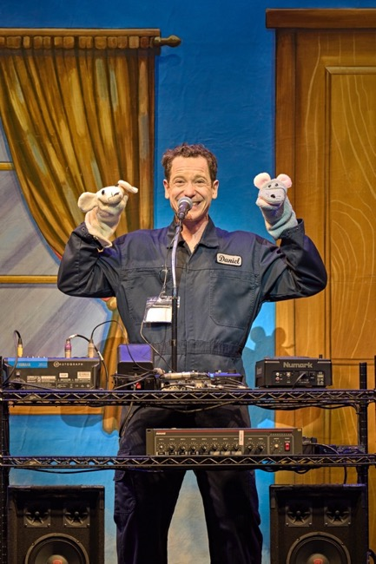
MEET THE CREATIVES…
Mrs. Doubtfire, the Musical, has been created by a transatlantic (British and American) team of award-winning artists. This includes ...
Original score and lyrics by the American song-writing team Karey and Wayne Kirkpatrick.
Book (script) written by Karey Kirkpatrick and British author, John O’Farrell
This team previously collaborated on the hit musical comedy Something Rotten!, a hilarious romp set in Shakespearean England, nominated for ten Tony Awards.

Slide 9
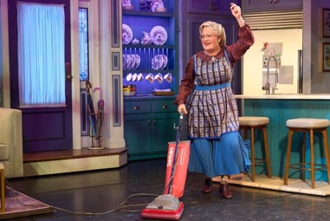
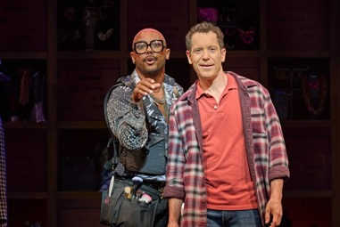
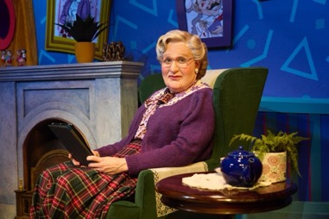
MEET THE CREATIVES…
Direction by four-time Tony Award winner Jerry Zaks.
One of the industry’s best for laughs, with a recent Broadway hit revival of
Hello, Dolly!
The musical stays true to the main plot of the book and film but has been set in the present day and updated for a contemporary audience.
It includes all the best moments from the film, elevated with singing and dancing!

Slide 10
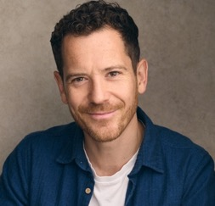
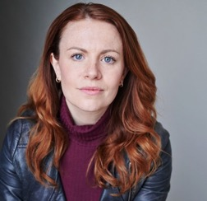
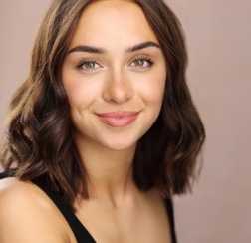
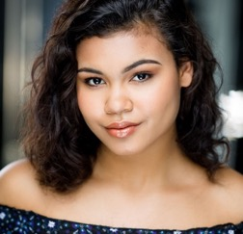
MEET THE 3 KEY CHARACTERS AND ENSEMBLE
THINK / PAIR / SHARE
Daniel Hilliard - Gabriel Vick
The Protagonist:
The character who drives the action, whose story we follow, and who we sympathise with.
Miranda Hilliard - Laura Tebbutt
The Antagonist:
The character who creates the drama by creating conflict with
the protagonist.
Lydia – Carla Dixon - Hernandez
The Straight Person:
The character who sits between the antagonist and protagonist and gives audiences a reference point for normality.
Ensemble
There are 13 including
Kiera Haynes, pictured, who plays Donna Summer. They sing, dance and multi role.

Slide 11
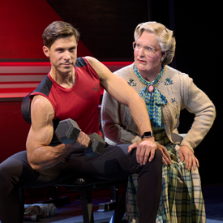
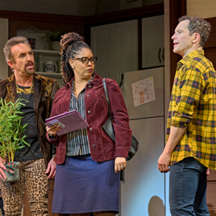
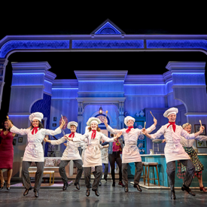
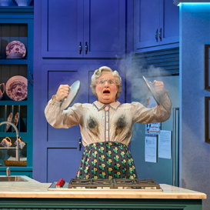
DISCUSSION
THINK / PAIR / SHARE
What are your first impressions of these three characters and their ‘types’?
What three adjectives would you use to describe each character?
How do you think the ensemble might be used in the story?

Slide 12
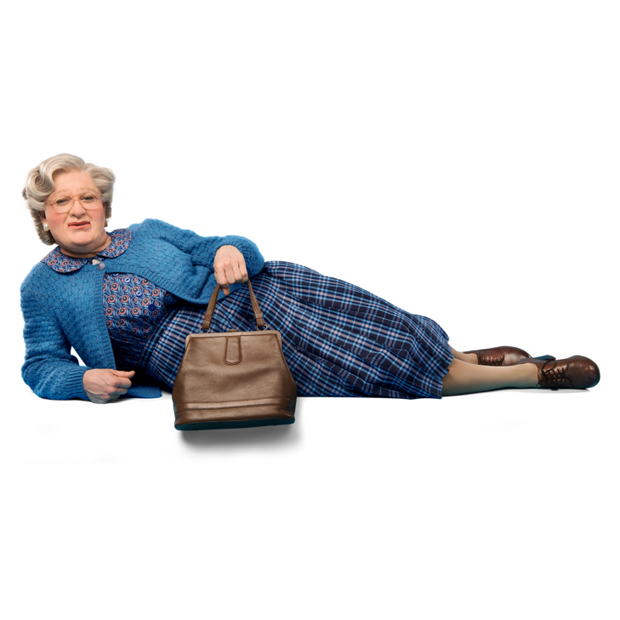
Being a parent is the
world’s hardest job!

Slide 13

Honesty is
the best policy
- Benjamin Franklin

Slide 14
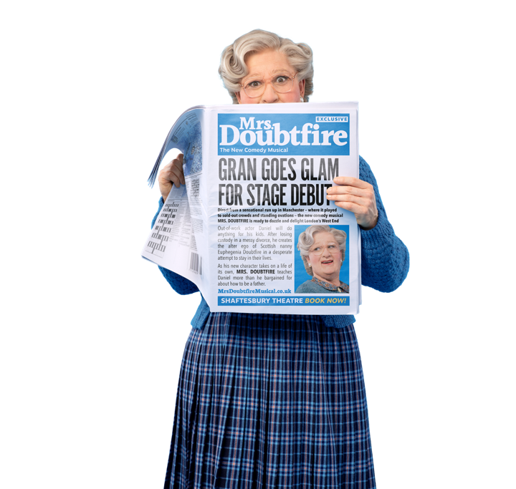
Family is where
life begins and
love never
ends…

Slide 15

Live life for
the moment…

Slide 16
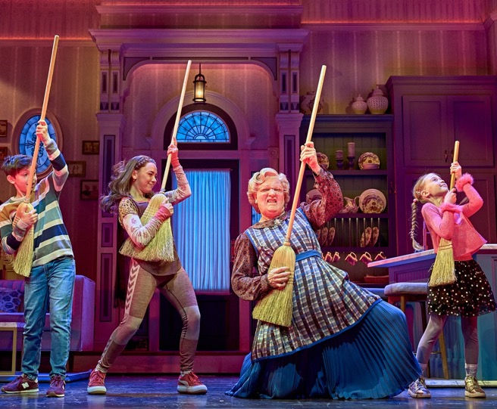
THEMES IN MRS DOUBTFIRE THE MUSICAL
The statements we have just explored relate to the production’s 3 themes;
Divorce/Separation
Transformation
Family and Love
Discussion:
Why is it important for an audience to connect with the themes in a production?
When you watch the production look out for how these themes are explored through the plot and characters.

Slide 17

THE MUSIC
THINK / PAIR / SHARE
Listen to the following clips of music from the production…
1. ‘What the Hell’ a rebellious rock song
2. ‘I Want to be There’ a heartfelt ballad
Can you identify the genre of each piece?
What mood or atmosphere do they each create?

Slide 18
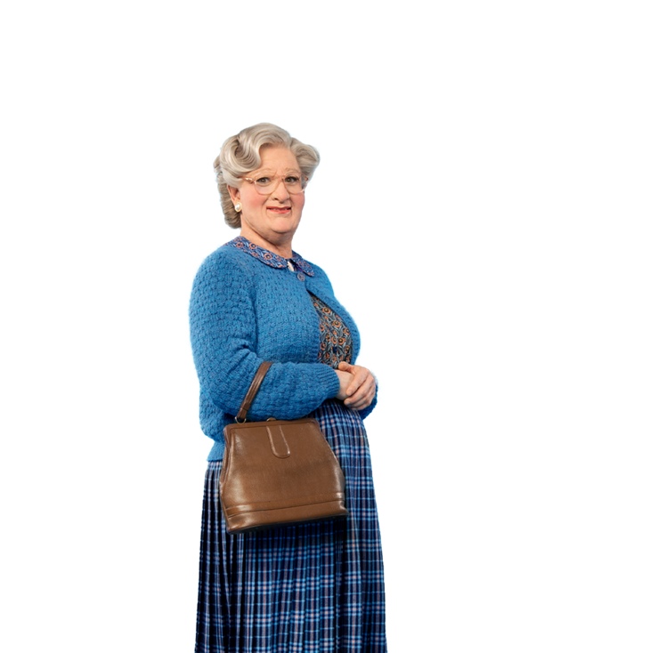
10 WORDS: WHOLE GROUP BRAINSTORM
As a whole group, can we identify and record 10 words to describe the production we are expecting to see…
I.e. entertaining, awareness raising, spooky, inspiring, shocking, reflecting, revealing, moving, confusing, edgy, bizarre, motivating, depressing, gripping, amusing, informing, documenting, enriching, uplifting…
We will review these 10 words after we have seen the production.

Slide 19

Enjoy your
visit poppets!

